Slide 1
Tutorial 11
Statistical Computation and Analysis
Spring 2025

Slide 2
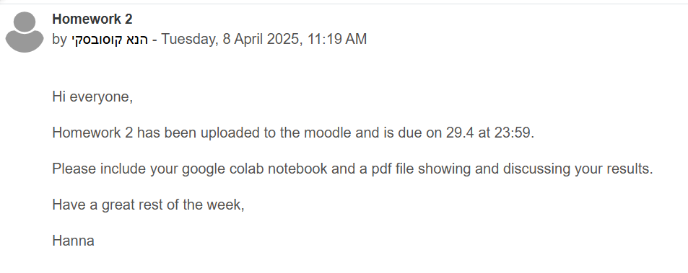
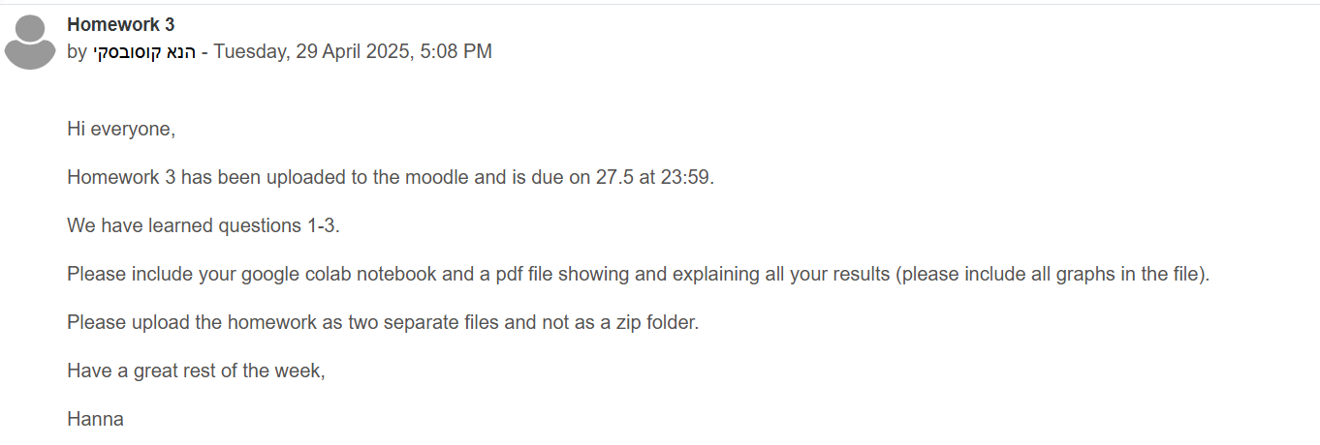
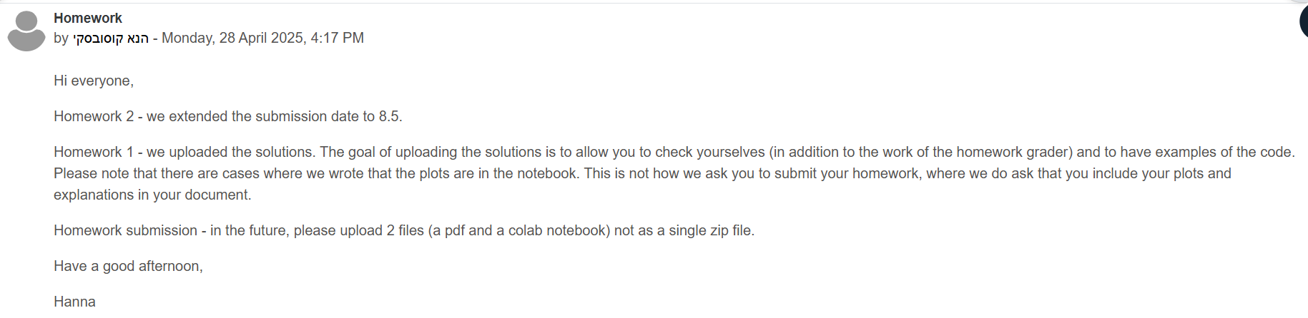
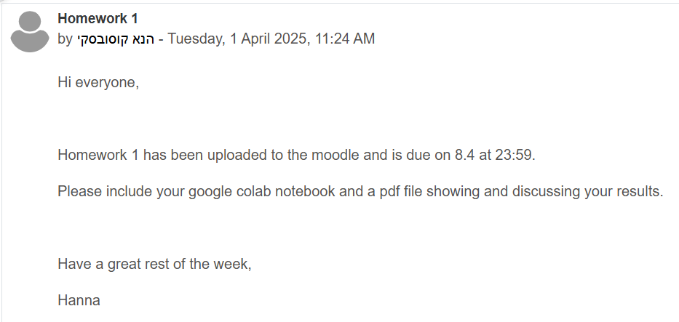
Homework Submission Format
Please submit a PDF report & Jupyter notebook (.ipynb file)!
The pdf report should include all plots and explanations.
Keep it organized and easy to read
Type it – don’t submit hand-written reports
If we can’t understand it – we can’t grade it…
If you only submit one – we will not check the assignment
If you submit the wrong format – we will deduct points (-5 now, next assignment -10)
This is not new information… חבל על הציון שלכם

Slide 3
Tutorial Outline
Categorical predictors
Bayesian reporting

Slide 4
Categorical predictors

Slide 5
Categorical Predictors
We mainly saw independent variables that were continuous.
There are cases when they are categorical.
Male, female
Morning, afternoon, evening
We can still do linear regression.
We need to encode the categorical variable as numbers.
Bambi

Slide 6
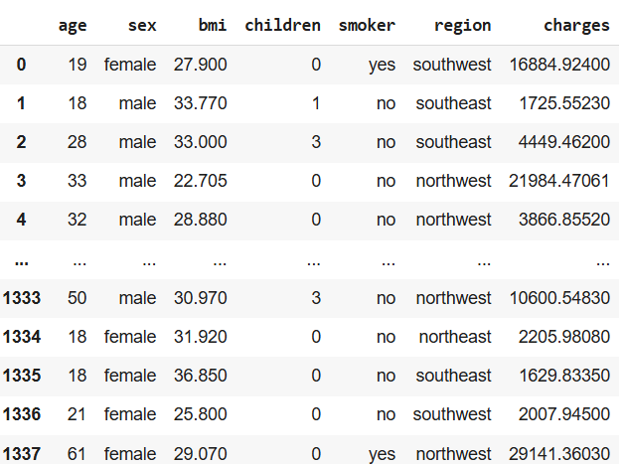
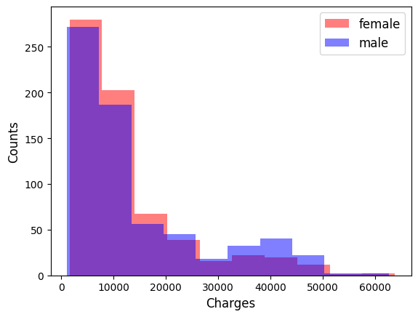
Categorical Predictors
We have insurance costs for males and females.

Slide 7

Categorical Predictors
Let’s use bambi to assess the effect of gender on insurance charges.
We don’t need to tell bambi if a variable is categorical.
Bambi detects and handles them automatically.
Notes:
Bambi recognizes object–dtype columns as categorical and applies treatment coding (also known as reference coding) by default. For a variable with K levels, it creates K−1 dummy columns, dropping one level as the baseline. You never have to do this by hand unless you want a different scheme.” – Note: treatment coding chooses, e.g., “female” as baseline and estimates the effect of “male” relative to that

Slide 8
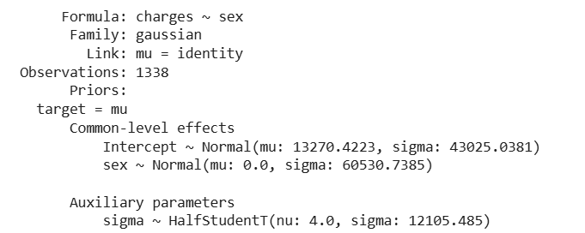

Categorical Predictors
We can examine the model:
The model that we fit is: $charges=β_{0}+b_{1}⋅sex$
Notes:
We fit charges ~ gender. Bambi builds one dummy (gender[T.male]). The intercept is the mean cost for the baseline (females), and the coefficient for male tells us how much more (or less) males pay on average. – Interpret both intercept and slope.

Slide 9
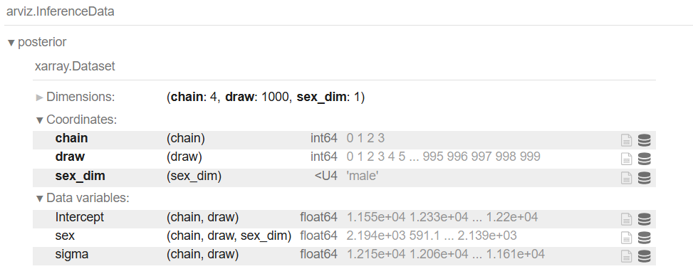
Categorical Predictors
And the inference data object:
Notes:
In our model, gender[T.male] ≈ +1380, so males pay about $1.38 K more than females.

Slide 10
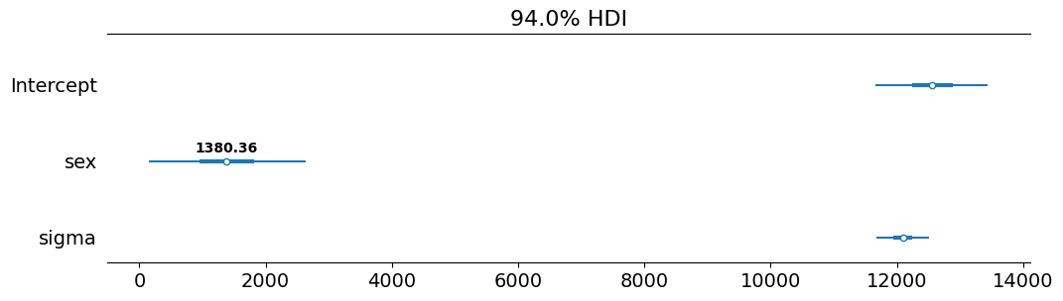
Categorical Predictors
We can see that the gender dimension is one, even though there are two genders.
Bambi encodes categorical variables with N levels (2 genders) as N-1 dummy variables (1 gender).
This means that on average the cost for males is 1380.36 more than for females.

Slide 11
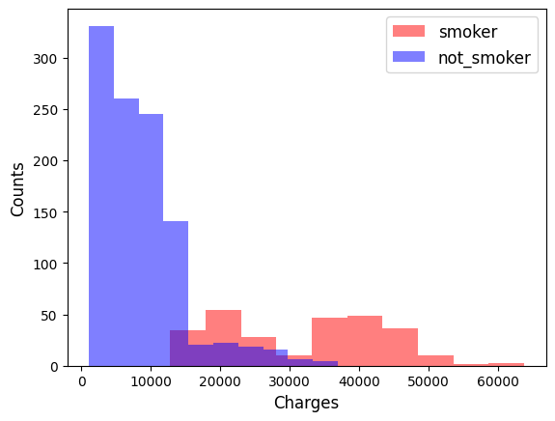
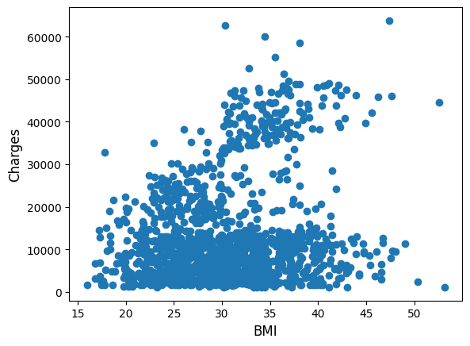
Categorical Predictors
Our dataset also contains other information, such as if the person smokes (categorical) and their BMI (continuous).

Slide 12


Categorical Predictors
We can fit a model to each independent variable.
Notes:
Next, we include smoker (yes/no).

Slide 13
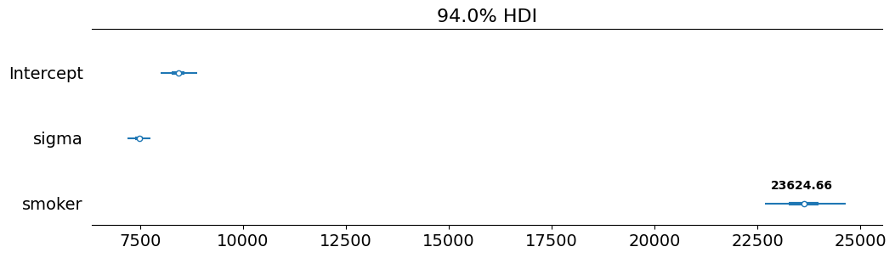
Categorical Predictors
Results smoker:
We need to add 23624 to smoker charges relative to not smoker.
Notes:
Again one dummy is created: smoker[T.yes]. Its coefficient (~+23,624) is the extra cost for smokers relative to non-smokers. When you add multiple categorical predictors, each is handled independently, so you get one coefficient per non-baseline level.” – coefficients are additive on the linear scale.

Slide 14
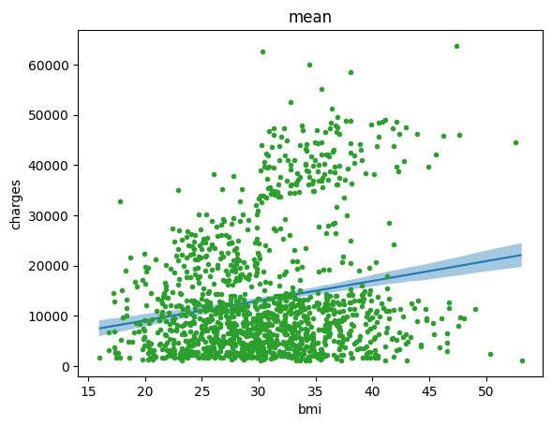
Categorical Predictors
Results bmi:

Slide 15
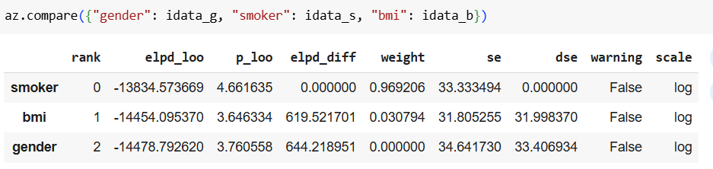
Categorical Predictors
How do we know which model is best?
We can compare using LOO.
And we can see that the smoker model is the best, as expected based on the data.

Slide 16
Multiple Regression
Instead of using only one variable at a time, we can use multiple regression.
For example, look at the regression of the insurance charges as a function of BMI (continuous) and smoker (categorical).
Notes:
We can mix: e.g., charges ~ bmi + smoker. Here bmi is continuous and enters as a slope, while smoker remains a dummy.
The bmi coefficient is the per-unit change in cost, averaged across both smoker statuses, holding smoker constant.

Slide 17
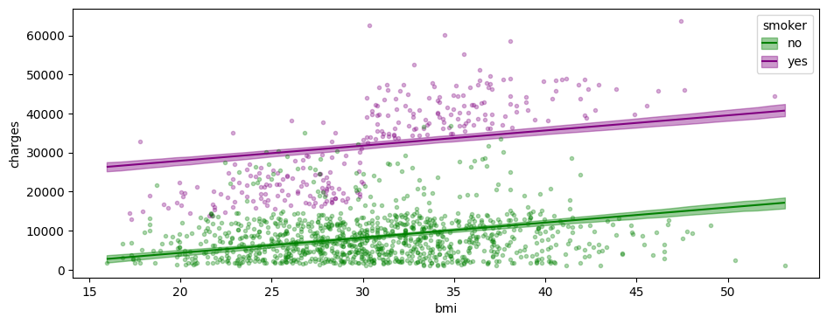
Multiple Regression
Results:

Slide 18
Multiple Regression
The results of this model show some relation between charges and bmi, and the difference we saw between smokers and non-smokers.
The two lines are essentially parallel to each other, with the difference in height showing the amount needed to add to the smokers’ charges.

Slide 19
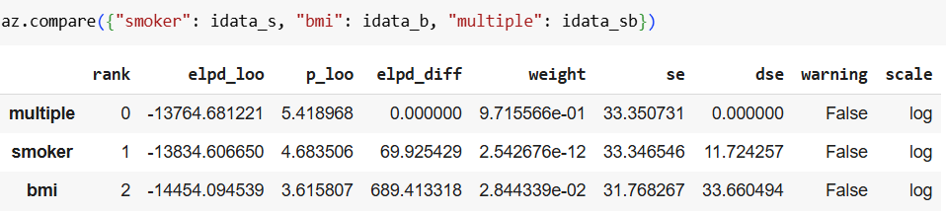
Multiple Regression
Let’s compare the multiple regression model to each of the two simple models:
We can see that the multiple regression model is better than the other two.
Notes:
We compare charges~gender, charges~smoker, and charges~bmi via LOO.
Unsurprisingly, the smoker model wins by a large margin, since smoking status explains the most variance in costs.

Slide 20
Interactions
An interaction effect happens when the effect of an independent variable on the response changes depending on the value of another independent variable.
For example, is the effect of bmi on charges different for smokers and not smokers?
This would be seen in the graph by not parallel regression lines after including the interaction term in the model.
Notes:
An interaction term, e.g. bmi:smoker, allows the slope of BMI to differ between smokers and non-smokers.
On the plot, lines will no longer be parallel.
If the interaction coefficient is positive, BMI has a stronger effect for smokers than non-smokers, and vice versa.

Slide 21

Interactions
How does the regression model look in this case?
$$charges=β_{0}+β_{1}⋅BMI+β_{2}⋅smoker+β_{3}⋅BMI⋅smoker$$
Main Terms
Interaction Term
Notes:
In our example, adding the bmi:smoker term improved LOO.

Slide 22
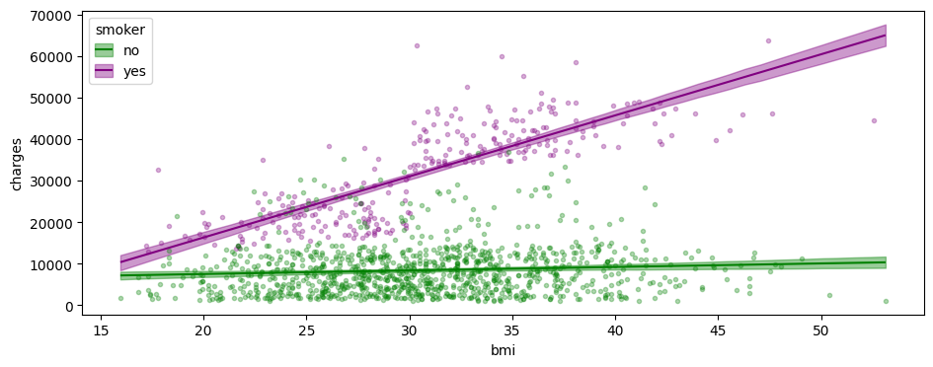
Interactions
Looking at the results of this model shows that now the two regression lines are not parallel.
Notes:
The posterior for the interaction is centered above zero, indicating that each unit of BMI increases cost more for smokers than for non-smokers by about $XXX per BMI-point.

Slide 23
Interactions
Comparing the results visually of this model and the one without the interaction term show better fit to the data.

Slide 24
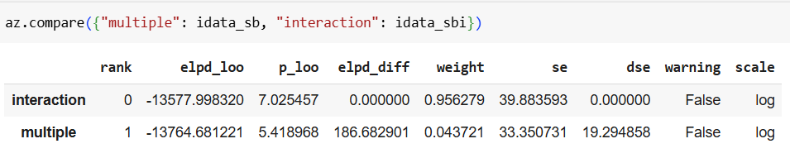
Interactions
Using model comparison also shows that the model with the interaction term is better than the model without.

Slide 25
Bayesian Reporting

Slide 26
When to Report Bayesian Statistics?
Scientific papers
Grant proposals & pre-registrations
Ethics / Regulatory approvals
Medical or engineering reports
Patents or industrial R&D

Slide 27
Different Reporting Standards & Norms
Different publication has different norms:
Clinical trials extremely strict (FDA guidance, etc.)
Pre-registered experiments: more flexible, but must include model‐and‐prior statements
Grant/IRB applications: require detailed description of priors, sampling algorithms, diagnostics.
Always check the reporting norm for your specific type of publication.

Slide 28
Three Levels of Reporting
Main Document (Methods & Results)
Appendix / Supplementary Material
Public Repository

Slide 29
Three Levels of Reporting
1. Main Document (Methods & Results)
Brief model description & equations
Rationale for prior choice
Diagnostics (e.g., convergence checks, R̂, ESS)
Methods for model comparison or hypothesis test
Summary of results:
HDI for each important parameter
HDI, ROPE (if applicable), and effect size for important comparisons
Model comparison table if appropriate

Slide 30
Three Levels of Reporting
2. Appendix / Supplementary Material
Full model specification: equations and diagram , all priors, hyperparameters, and sampling algorithms.
Additional diagnostic plots (prior predictive checks; posterior predictive checks; trace & rank plots)
Results: Table of parameters with the mean, HDI, ESS and MCSE,prior or prior HDI (if applicable).

Slide 31
Three Levels of Reporting
3. Public Repository
Data (raw or preprocessed), plus instructions to regenerate any derived datasets
Code: a Jupyter notebook or script that reproduces all steps:
Loads dataDefines and fits models (with explicit seed setting for reproducibility)
Produces all summary tables and diagnostic figures (saved as PNG/PDF)
Generates tables for main text and appendix
Extra analyses that didn’t make the paper (e.g., alternative models, sensitivity to priors)

Slide 32
Example (open attached PDF)
Volotsky, Svetlana, Opher Donchin, and Ronen Segev. “The Archerfish Uses Motor Adaptation in Shooting to Correct for Changing Physical Conditions.” Edited by Kunlin Wei and Tamar R Makin. eLife 12 (June 3, 2024): RP92909. https://doi.org/10.7554/eLife.92909.
Pech, Guillaume P, and Emilie A Caspar. “A Cross-Cultural EEG Study of How Obedience and Conformity Influence Reconciliation Intentions.” Social Cognitive and Affective Neuroscience 20, no. 1 (January 18, 2025): nsaf038. https://doi.org/10.1093/scan/nsaf038.
Notes:
Volotsky et al. (2023) demonstrate that archerfish employ error-driven motor adaptation when shooting water jets at aerial targets.
By introducing controlled airflow perturbations, they showed an immediate increase in shot error, followed by gradual error reduction over trials and a reversed “aftereffect” once the airflow ceased.
A hierarchical Bayesian analysis confirmed robust, egocentric adaptation across individual fish, revealing that archerfish learn to anticipate and compensate for changing physical conditions.

Slide 33
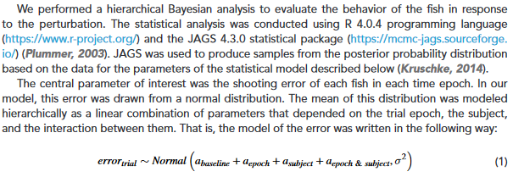
1) Main Document (Methods)
Model Description & Prior Selection

Slide 34
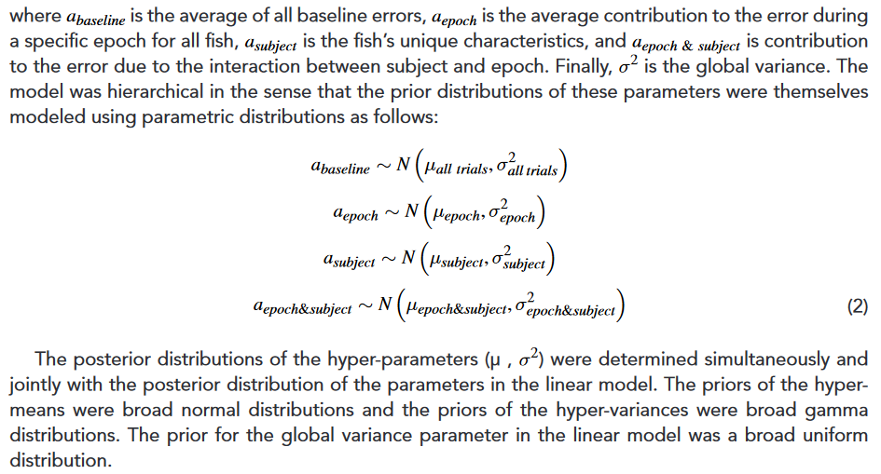
1) Main Document (Methods)
Model Description & Prior Selection

Slide 35
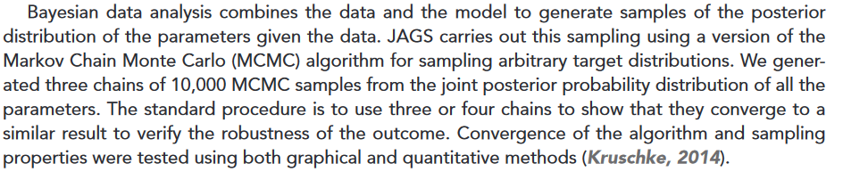
1) Main Document (Methods)
Sampling

Slide 36
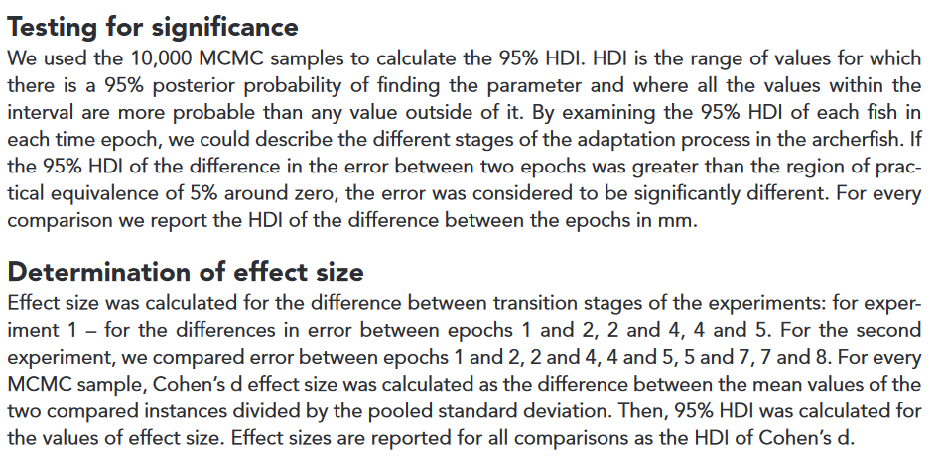
1) Main Document (Methods)
Significance & Effect Size

Slide 37
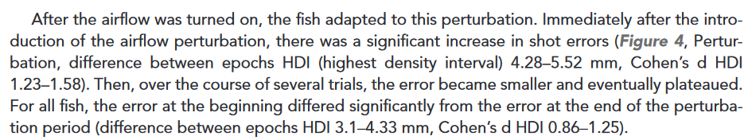
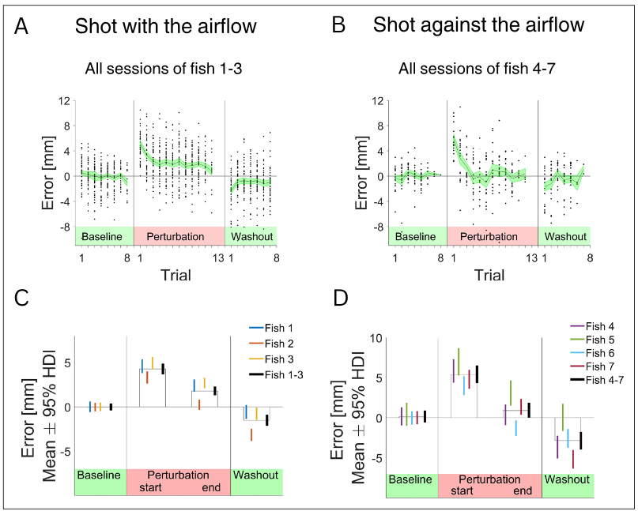
1) Main Document (Results)
HDI and Effect Size(one example)

Slide 38
1) Main Document (Results)
HDI and Effect Size (one example)
(C) For three fish that shoot in direction 1: Mean value of the error and 95% highest density interval (HDI) for epoch 1 – the baseline, epoch 2 – first two trials after the introduction of the airflow, epoch 4 – last two trials before the termination of the perturbation, epoch 5 – first two trials after the termination of the perturbation.
(D) For the four fish that shot in direction 2: Mean value of the error and 95% HDI.

Slide 39
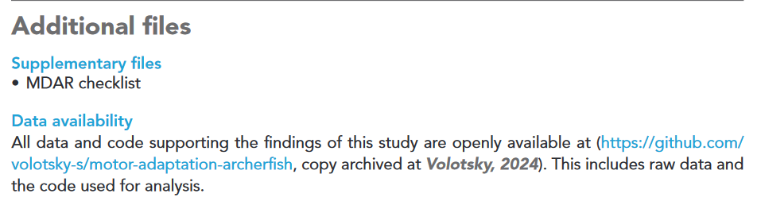
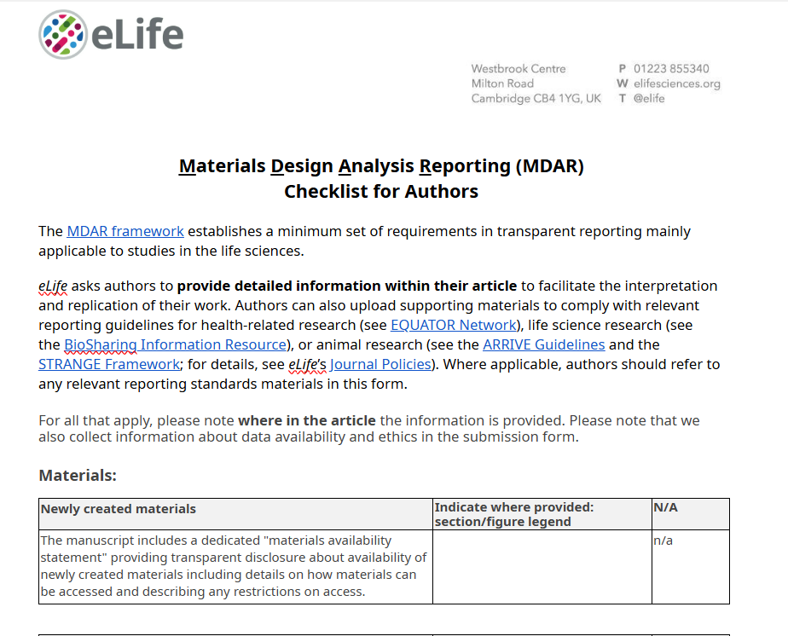
2) Appendix
Supplementary Material
The journal’s standardized Materials Design Analysis Reporting form that authors complete to ensure full transparency and reproducibility of their work.
https://cdn.elifesciences.org/articles/92909/elife-92909-mdarchecklist1-v1.docx
Notes:
https://cdn.elifesciences.org/articles/92909/elife-92909-mdarchecklist1-v1.docx

Slide 40
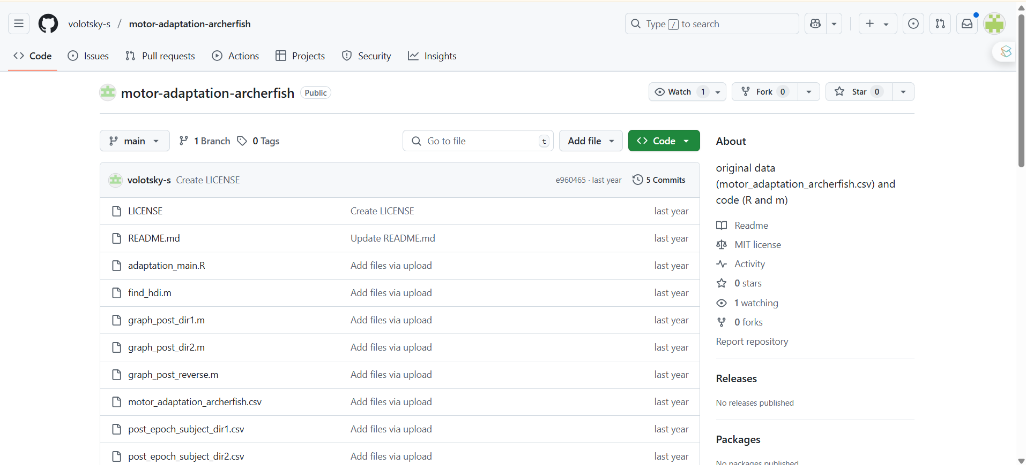
3) Public Repository
Data availability & Code
https://github.com/volotsky-s/motor-adaptation-archerfish
Notes:
https://github.com/volotsky-s/motor-adaptation-archerfish

